Slide 1
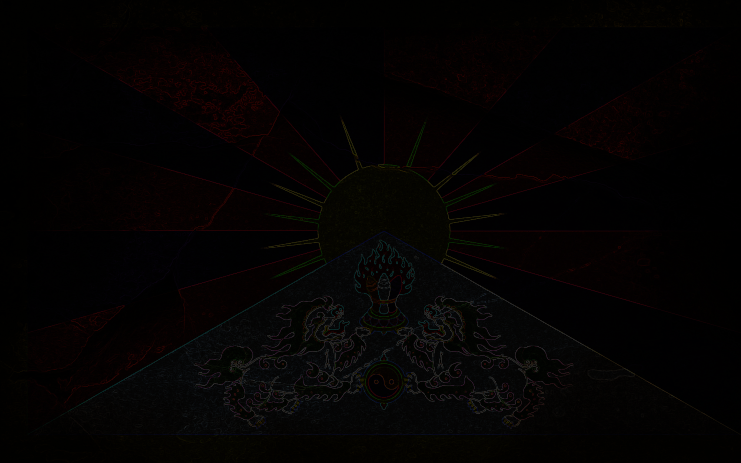
Quiz template

Slide 2

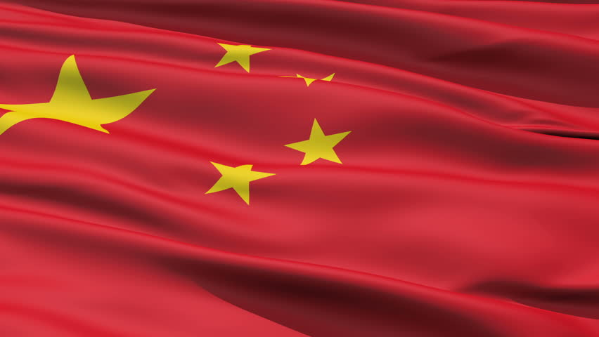
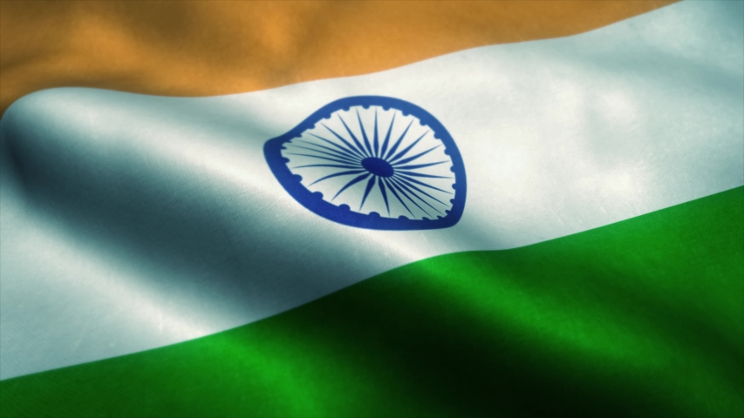

Tibet belongs to …?
India
China
USA
Tibetans

Slide 3
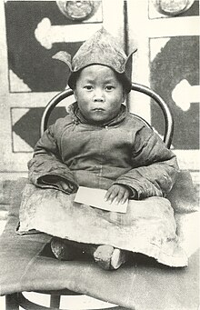
What is the birth name of
His Holiness the 14th Dalai Lama?
Tenzin Kalden
Lhamo Dhondup
Tenzin Gyatso
Dalai Lama

Slide 4
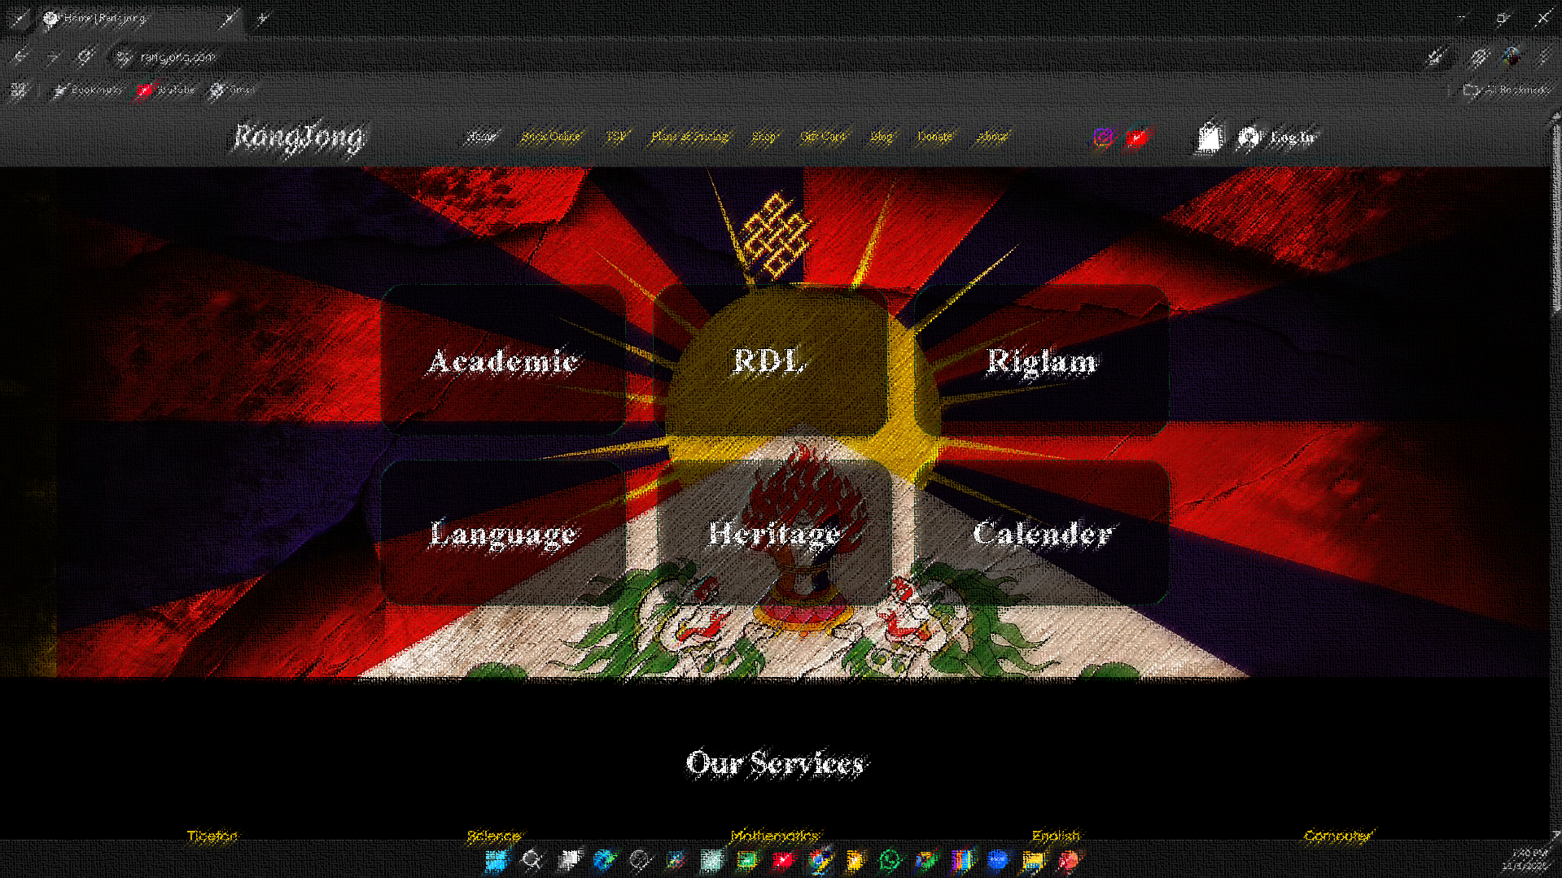
What is the name of gyenlak Kalden’s website?
Rangjong.com
Rangjong channel
Facebook.com
Youtube.com

Slide 5
Bhoe Gyalo

Slide 6
Question
Correct option
Incorrect option
Incorrect option
Incorrect option

Slide 7

Subscribe
if you find this ppt useful.

Slide 8
Correct

Slide 9
INCORRECT!

