Slide 1


Slide 2

Metals
And
Non Metals
Created by: Tenzin Kalden, RangJong Find us on www.rangjong.com

Slide 3
A. PHYSICAL PROPERTIES OF METALS & NON-METALS:
PROPERTIES | METAL | NON-METAL
1. METALLIC LUSTRE (SHINE) | Present | Absent. Except iodine.
2. HARDNESS | Generally hard. Except Sodium, lithium and potassium – which are soft and can be cut easily. | Generally soft, expect diamonds i.e., a form of carbon, considered the hardest natural substance.
3. State | Exists in solid except Mercury (liquid form) | Exists as solids and gases. Except Iodine (liquid).
4. Malleability (thin sheet) | Malleable | Non-malleable
5. Ductility (wire) | Ductile | Non-ductile
6. Heat and electricity conduction. | Good conductor | Poor conductor / insulator.
7. Density | Have high density. Thus have high Melting and Boiling point. | Low density. Hence, low M.P and B.P.
8. Sonorous (Ringing sound) | Present | Absent
9. Oxides | Metal oxides are basic in nature. | Non-metal oxides are acidic in nature.

Slide 4

B. CHEMICAL PROPERTIES OF METALS:

Slide 5
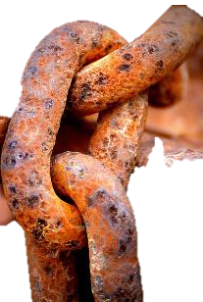
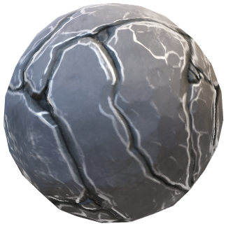
B1. REACTION OF METALS WITH AIR:
O₂
Metal oxide
Metal
Examples:
a. Cu + O₂ → CuO (copper oxide) {unbalanced}
* 2Cu + O₂ → 2CuO {balanced}
b. 4Al + 3O₂ → 2Al₂O₃ (Aluminium oxide)
c. 2Mg + O₂ → 2MgO (Magnesium oxide)
NOTE:
Na & K react vigorously with air and water. Hence, are always kept submerged in kerosene or paraffin liquid.
Cu is coated with black copper oxides on exposure to oxygen.
Ag & Au doesn’t react with oxygen.

Slide 6
B2. Amphoteric oxides:
Metal oxides which react with both acids as well as bases to produce salt & water are called Amphoteric oxides.
Examples:
a. Al₂O₃ + 6HCL → 2AlCl₃ + 3H₂O (reaction with acid)
(Aluminium oxide) (Aluminium chloride)
b. Al₂O₃ + 2NaOH → 2NaAlO₂ + H₂O (reaction with base)
(Aluminium oxide) (Sodium aluminate)
Created by: Tenzin Kalden, RangJong Find us on www.rangjong.com

Slide 7
B3. Reaction of metals with water:
Examples:
2Na (s) + 2H₂O (l) → 2NaOH (aq.) + H₂ (g) + heat energy.
2K (s) + 2H₂O (l) → 2KOH (aq.) + H₂ (g) + heat energy.
Pb + H₂O (l) → no reaction.
Ca + 2H₂O (l) → Ca(OH)₂ + H₂ (g)
Reaction with variants of water forms and temperatures:
Metals reacting with cold H₂O:
* Na, K, Ca.
2. Metals reacting with Steam H₂O:
* Al, Fe, Zn.
3. Metals reacting with Hot H₂O:
*Mg.
4. Metals that do not react with H₂O:
*Pb, Cu, Ag, Au.
5. Ca and Mg float as bubbles of H₂ stick to their surface.
Created by: Tenzin Kalden, RangJong Find us on www.rangjong.com

Slide 8
B4. Reaction of metals with Acids:
Metal
Dilute Acid
Salt + H₂
EXAMPLES:
a. Fe + 2HCL → FeCl₂ + H₂
b. Mg + 2HCl → MgCl₂ + H₂
c. Zn + 2HCl → ZnCl₂ + H₂
d. 2Al + 6HCl → 2AlCl₃ + 3H₂
Note:
H₂ is not produced when metals reacts with HNO₃ as it is a strong oxidizing agent.
HNO₃ oxidises the H₂ to water and itself get reduced to N₂O, NO or NO₂.

Slide 9
B5. Reaction of metals with solution of other metal salts:
Metal A Salt solution
Metal A
Metal B Salt solution
Metal B
Reactive metals can displace less reactive metals from their compounds in solution form:
Example: a. Fe + CuSO₄ → FeSO₄ + Cu
b. Cu + FeSO₄ → no reaction (Why?) *see next slide.
Created by: Tenzin Kalden, RangJong Find us on www.rangjong.com

Slide 10
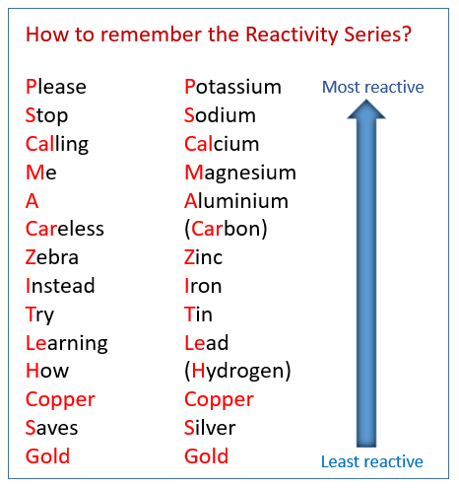
C. Reactivity Series of metals
It is the series of metals arranged in order of their reactivity from highest to lowest.
It helps in determining the products of single displacement reactions.
INCREASING ORDER:
Au < Ag < Cu < H < Pb < Sn < Fe < Zn < C < Al < Mg < Ca
< Na < K
DECREASING ORDER:
K > Na > Ca > Mg > Al > C > Zn > Fe > Sn > Pb > H > Cu
> Ag > Au

Slide 11
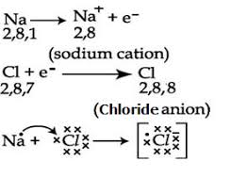
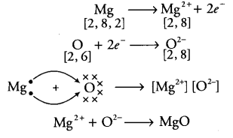
D. Reaction of metals with non-metals
Reactivity of elements is the tendency to attain a completely filled valence (outermost) shell.
Atoms of the metals lose electrons from their valence shell to form cation (+).
Atoms of non-metals gain electrons in the valence shell to form anions (-).
The compounds formed by the transfer of e- from a metal to a non-metal is called Ionic compounds / electrovalent compound.
DISCUSS THESE TWO FORMATIONS WITH YOUR TEACHER.

Slide 12
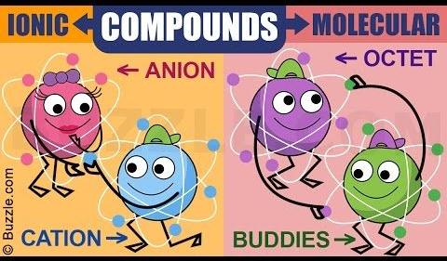
E. Properties of Ionic compounds
1. Physical nature:
→ Are solid, hard but brittle.
2. M.P. & B.P:
Have high M.P and B.P.
3. Solubility:
→ Soluble in water, insoluble in solvents such as kerosene, petrol etc.
4. Electric conduction:
Conducts electricity in molten and solution form but no conduction in solid form.
* examples: NaCl and MgCl₂.
Created by: Tenzin Kalden, RangJong Find us on www.rangjong.com

Slide 13
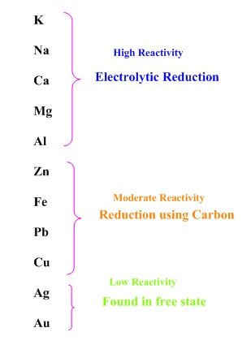
F. Extraction of metals from the crust.
Metals occur in:
a. Minerals:
The element or compounds which occur naturally in earth’s crust.
b. Ores:
Minerals that contain very high % of particular metal and the metal can be extracted from it. Such minerals are known as Ores.
Not found in free state
STEPS INVOLVED IN EXTRACTION OF PURE METAL FROM ORES:
Enrichment of ores.
Extraction of metals.
Refining of metals.
Found as oxides, sulphides or carbonates
Created by: Tenzin Kalden, RangJong Find us on www.rangjong.com

Slide 14
IMPORTANT TERMS TO BE USED:
EXTRACT
I
ON
Gangue: Ores found contaminated with large amount of impurities such as soil, sand etc.
2. Roasting: Converting sulphide ores into oxides by heating strongly in the presence of excess air.
2ZnS + 3O₂ + heat → 2ZnO + 2SO₂ (*Heating in presence of oxygen)
3. Calcination: The process of changing carbonate ores into oxides by heating strongly in limited air.
ZnCO₃ + heat → ZnO + CO₂ (*Heating in absence of oxygen)
4. Reduction: Metal oxides are reduced to corresponding metals by the used of reducing agent like Carbon.
ZnO + C → Zn + CO
Created by: Tenzin Kalden, RangJong Find us on www.rangjong.com

Slide 15
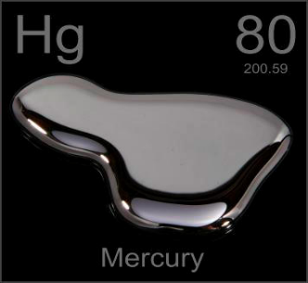
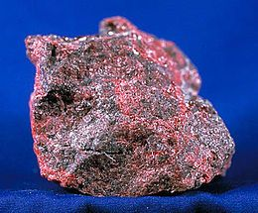
G. Extraction of metals with low reactivity.
Example:
1. Cinnabar (HgS) → an ore of mercury:
a. 2HgS(s) + 3O₂(g) + Heat → 2HgO(s) + 2SO₂(g)
(Mercuric oxide)
b. 2HgO(s) + Heat → 2Hg(l) + O₂(g)
USES OF MERCURY:
Thermometer.
Barometer.
Circuit boards.
Batteries.
Electric switches.
Printer and Xerox toners.

Slide 16
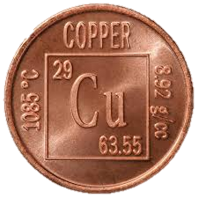
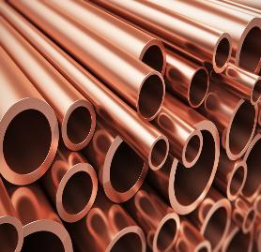
Example: 2. COPPER:
a. 2Cu₂S(s) + 3O₂(g) + Heat → 2Cu₂O(s) + 2SO₂(g)
(cuprous oxide/copper oxide)
b. 2Cu₂O(s) + Cu₂S + Heat → 6Cu(s) + SO₂(g)
USES OF COPPER:
1. Electric wire and motors.
2. In plumbing and in cookware.
3. Roofing etc.
Created by: Tenzin Kalden, RangJong Find us on www.rangjong.com

Slide 17
H. Extraction of metals in middle of reactivity series.
Ex: Ferrous (Fe), Zinc (Zn), Lead (Pb) etc. → are usually present in sulphides / carbonates in nature.
Ex: 1 → Zinc ore
a. Roasting: 2ZnS(s) + 3O₂(g) + Heat → 2ZnO(s) + 2SO₂(g)
b. Calcination: ZnCO₃(s) + heat → ZnO(s) + CO₂(g)
c. Reduction: ZnO(s) + C(s) → Zn(s) + CO₂(g)
*Using highly reactive metals as reducing agent to displace lower reactive metals.
ex: x. 3MnO₂(s) + 4Al(s) → 3Mn(l) + 2Al₂O₃(s) + Heat
y. Fe₂O₃(s) + 2Al(s) → 2Fe(l) + Al₂O₃(s) + Heat
Created by: Tenzin Kalden, RangJong Find us on www.rangjong.com

Slide 18
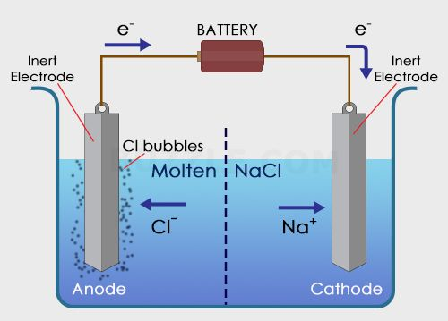
I. Extraction of metals of top reactivity series.
Ex: Sodium (Na), Magnesium(Mg), Calcium(Ca) are obtained by electrolysis of their molten chlorides.
Metals get deposited at the cathode (-vely charged electrode) where as chlorine is collected at the anode (+vely charged electrode).
Reaction: At cathode = Na⁺ + e⁻ → Na
At Anode = 2Cl⁻ → Cl₂ + 2e⁻
Created by: Tenzin Kalden, RangJong Find us on www.rangjong.com

Slide 19
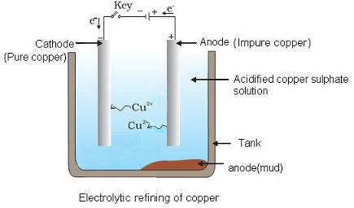
J. Refining of metals
@Anode: impure copper
@Cathode: Strip of pure copper
In Electrolyte: solution of acidified copper sulphate.
On passing the current through electrolyte, the impure metal from anode dissolves into the electrolyte.
An equivalent amount of pure metal from the electrolyte is deposited at the cathode.
The insoluble impurities settle down at the bottom of the anode and is called ‘Anode mud’.
Refining is basically done to remove any impurities that may have remained along the extracted metal.
Most common method used is electrolytic refining.
Created by: Tenzin Kalden, RangJong Find us on www.rangjong.com

Slide 20

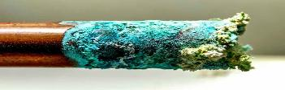
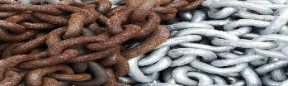
K. Corrosion
METAL | CHANGE IN COLOUR WHEN EXPOSED TO AIR | NAME OF THE SUBSTANCE | IMAGE
Silver (Ag) With O₂ | Black | Silver sulphide Ag₂S
Copper (Cu) With CO₂ | Green | Copper carbonate Cu₂(OH) ₂CO3
Iron/ferrous (Fe) With O₂ | Brown | Ferrous oxide Fe₂O₃
It is the conversion of refined metals into rust due to the exposure of moist air (O₂ or CO₂) for a long period of time.
Created by: Tenzin Kalden, RangJong Find us on www.rangjong.com

Slide 21
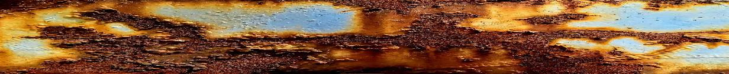
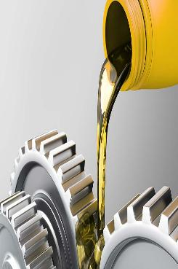
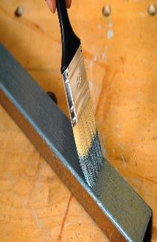
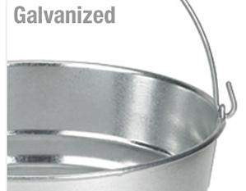
How to prevent corrosion
4. Alloys:
Alloys are homogenous mixture of 2 or more metals or a metal and a non-metal.
Examples:
Steel → Iron + Nickel + Chromium
Brass → Cu + Zn
Bronze → Cu + Sn (tin)
Solder → Pb (Lead) + Sn
3. Galvanization:
→ It is the method of protecting steel & iron from rusting by coating them with a thin layer of zinc (Zn)
2. Oiling
1. Painting
Created by: Tenzin Kalden, RangJong
Find us on www.rangjong.com

