Slide 1

Visit www.rangjong.com for more such resources.

Slide 2
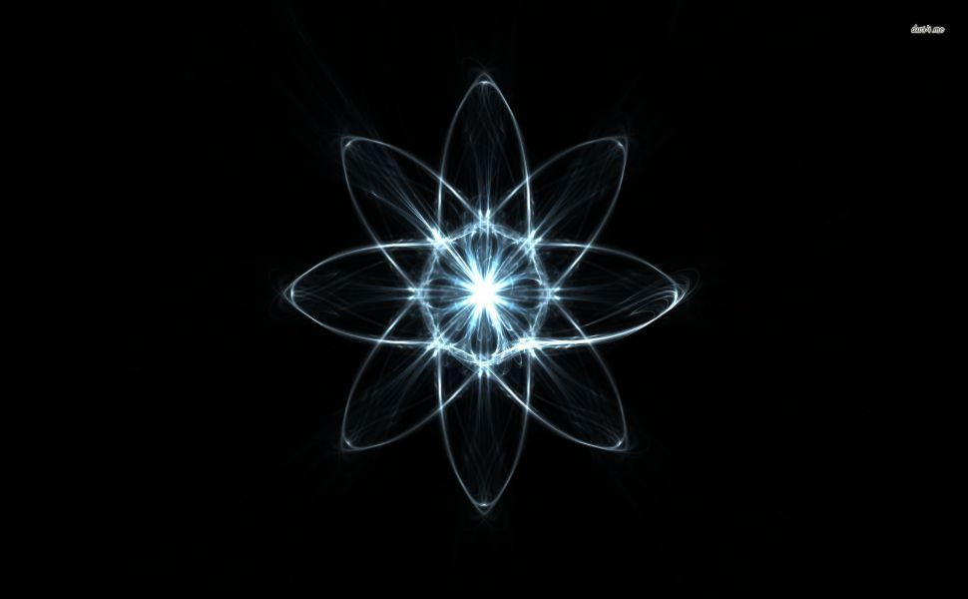
ATOMS &
MOLECULES
Class IX Chapter 3.

Slide 3
1
ATOM
LAWS OF CHEMICAL COMBINATION
1. Law of conservation of mass | 2. Law of constant proportions
→ It states that the mass can neither be created nor be destroyed in a chemical reaction. | Aka- law of definite proportion and was stated by Proust. It states that, in a chemical substance the elements are always present in definite proportions by mass.
Ex: Interconversion of states of water. | Ex: The ratio of mass of hydrogen to the mass of oxygen is always 1:8 of water, despite the source.
Characteristic features:
1. Atomic radius is measured in nanometres. i.e., 1m = 10⁹ nm.
2. Atoms comprise of a nucleus and atomic shells.
3. Atoms are the building blocks of all known matter.
4. Atoms make up elements, elements make up molecules, and then into compounds.
Atoms are considered the smallest particle of a chemical element that can exist in nature on its own.
The father of chemistry, Antoine L. Lavoisier laid the foundation of chemical sciences and established two important ‘Laws of chemical combination’ along with Joseph L. Proust.

Slide 4
2
Iron
Dalton’s atomic theory
He postulated (suggested) that:
1. All matter is made of tiny particles called atoms which participates in chemical reaction.
2. Atoms are indivisible, which cannot be created or destroyed.
3. Atoms of same element are identical in mass and chemical properties.
4. Atoms of different elements have different masses and chemical properties.
5. The relative number and kinds of atoms are constant in a given compound.
carbon
C
C
C
C
C
C
C
C
C
C
C
C
C
Different elements with different masses and different chemical properties.
Carbon compound
Water from clouds is H₂O
Ocean water is also H₂O
Bottle water is also H₂O

Slide 5
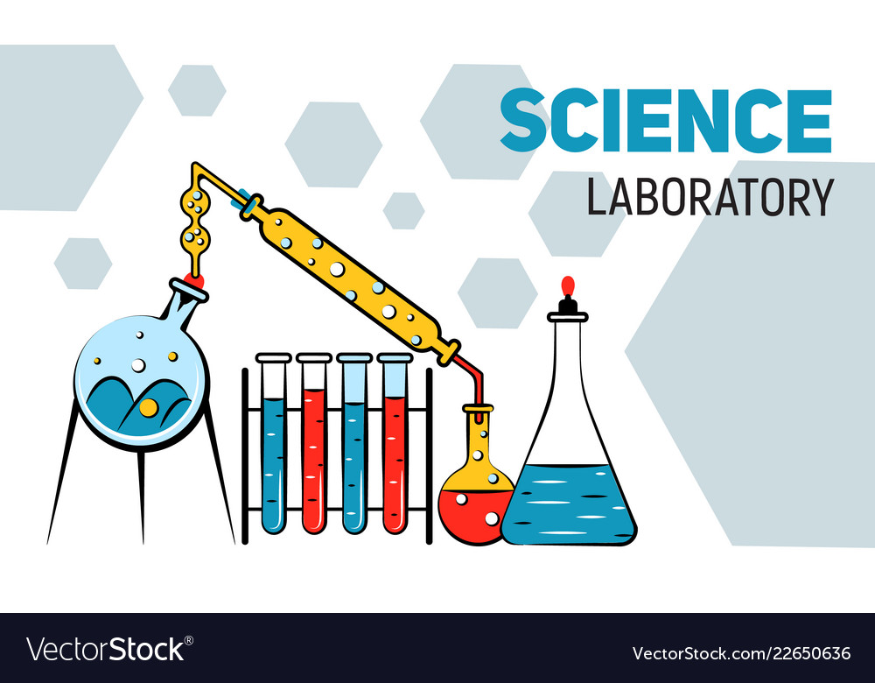
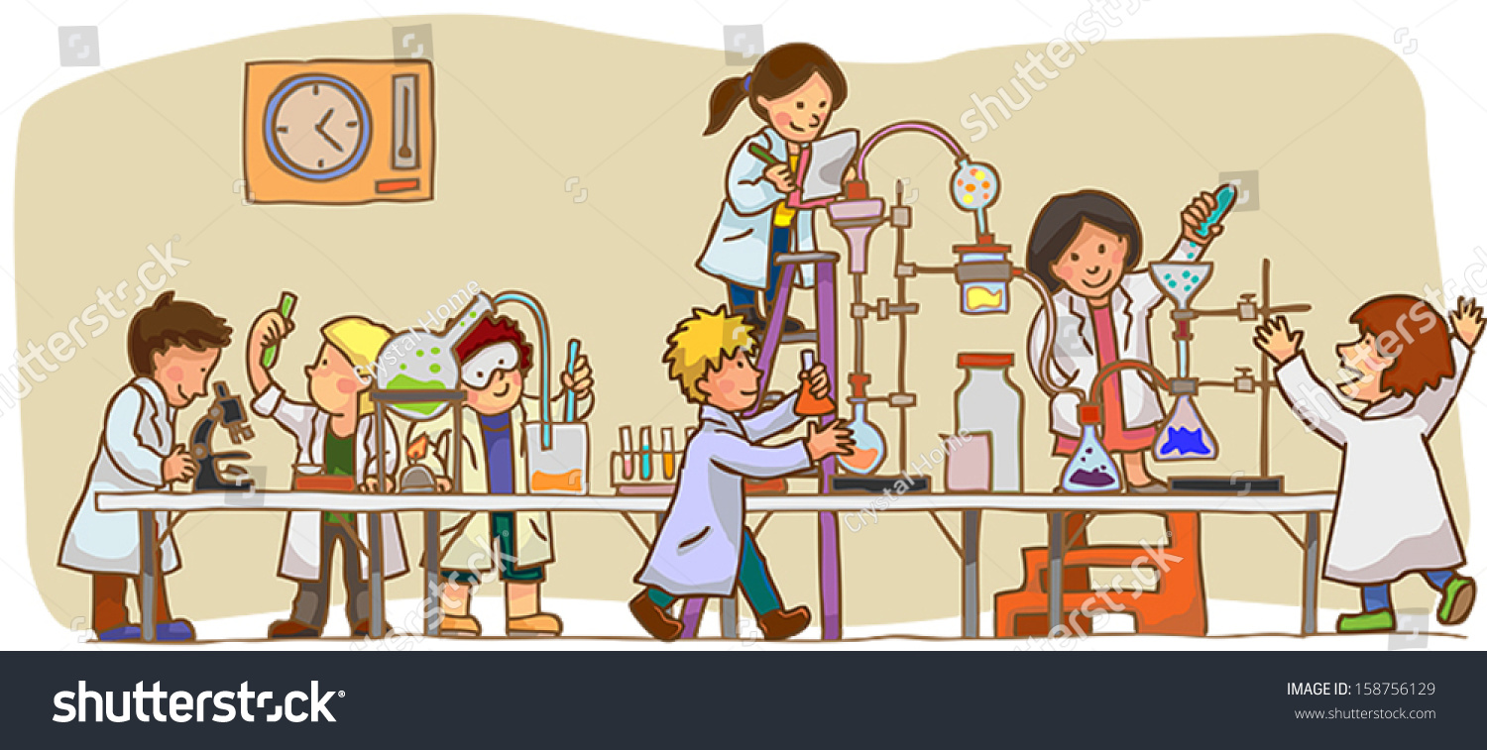

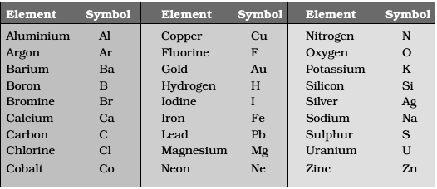
3
*Some symbols of the elements are taken from their Greek, Latin or German name.
Ex: Fe (ferrum) for iron aka ferrous,
Na (Natrium) for sodium,
K (Kalium) for Potassium etc.
Naming of elements/atoms
Primarily symbols of atoms for different elements are based on:
The name of the place from where they were discovered.
Ex: Copper from Cyprus.
2. Colour of the element.
Ex: Gold from Golden.
In Modern days, IUPAC (International Union for Pure and Applied Chemistry) approves the names, symbols and units of the elements.
*Many of the symbols are the first two letters of the element’s English name.
The 1st letter written in capital and 2nd in Lower case.
Ex: H for Hydrogen, Al for aluminium, Mg for Magnesium.
Symbols for some elements

Slide 6
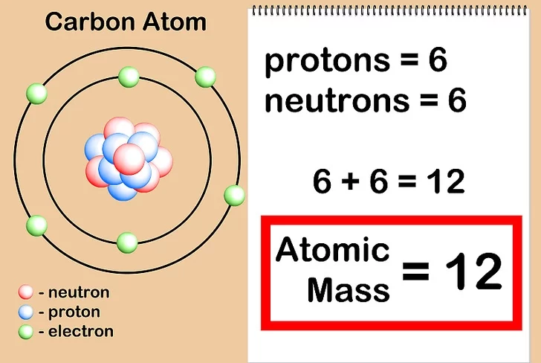
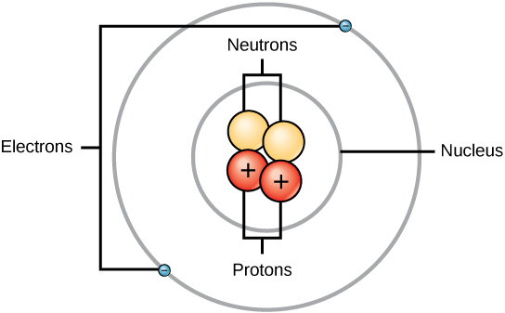
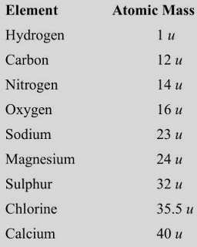
4
Atomic mass and what’s inside:
Atomic Mass: It is the mass of the total number of particles inside the nucleus of atom.
An atom is made up of the following particles:
Electron: Revolves around the nucleus of the atom in its orbits.
*it is a negatively charged particle.
b. Proton: It is present in the nucleus. Usually equal in number of electrons but is positively charged.
c. Neutron: It has no charge (neutral) and makes up the nucleus with proton.
You will learn more about this in class X. Feel free to check it out on your own.
Atomic mass is expressed in either Dalton (Da) or unified mass (u). These two are the S.I. units for atomic mass.
Atomic masses of few elements

Slide 7
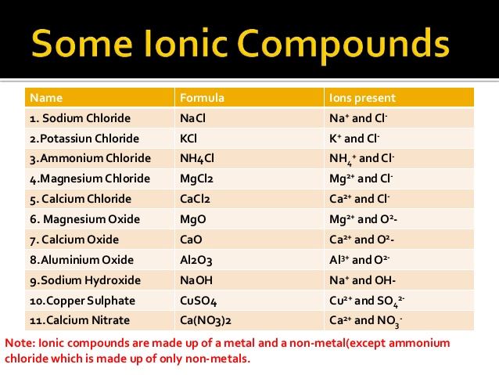
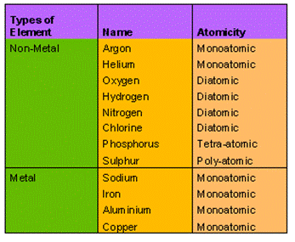
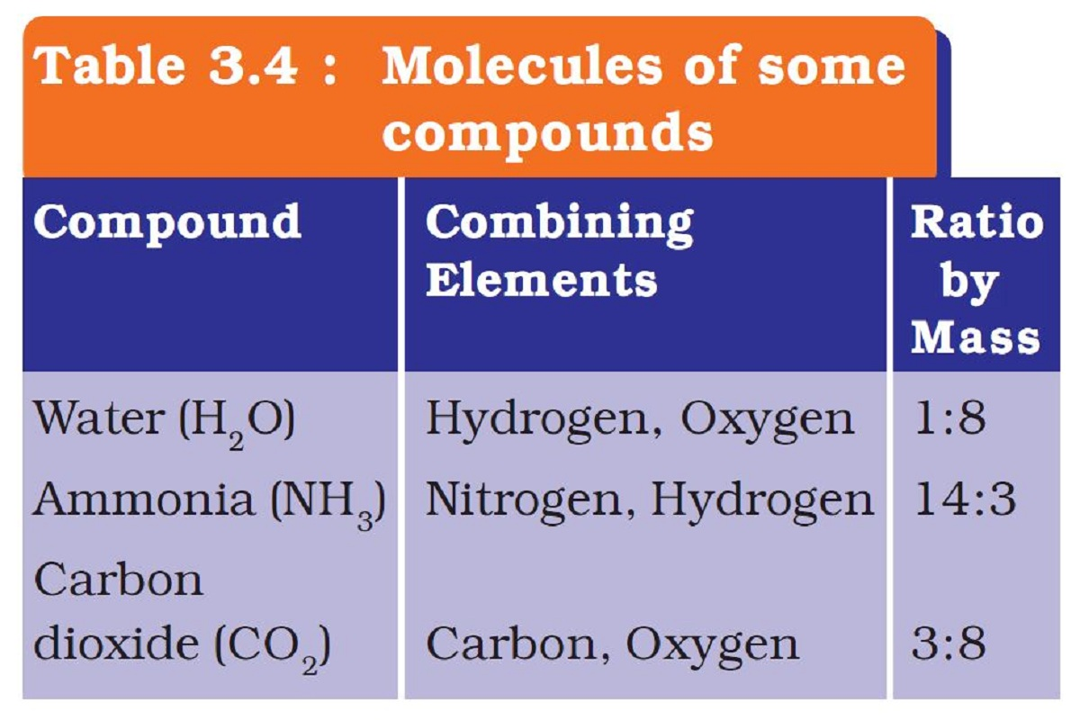
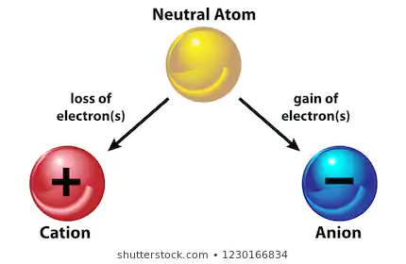
5
Molecules and ions:
Atoms of different elements can join to form molecules as well.
Ion:
Ions are elements with
charges (+ and – ve charges)
- ve charge is called ‘Anion’ and + ve charge is called ‘Cation’.
The ions may consist of a single atom or a group of atoms with the net charge on them.
A group of atoms carrying a charge is known as a polyatomic ion.
A molecule is a group of two or more atoms that are chemically bonded together by attractive forces.
It is the smallest particle of an element or a compound that is capable of existing independently.
MOLECULES OF ELEMENTS:
It constitutes (has) of same type of atoms.
Some are monoatomic (only 1 atom).
Some are diatomic (2 atoms of same element).
Some are tetra-atomic (4 atoms of same element).
* If the atomicity (the no. of atoms in a molecule) is altered, the chemical changes and shows different properties.
MOLECULES OF COMPOUNDS:
Atoms of different elements join together to form molecules of compounds.
The Atoms are joined in definite proportions.
ions

Slide 8
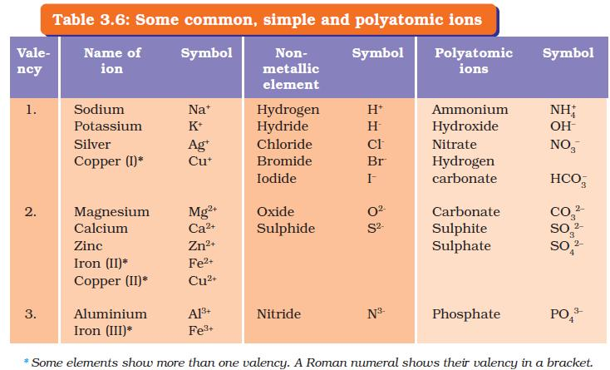
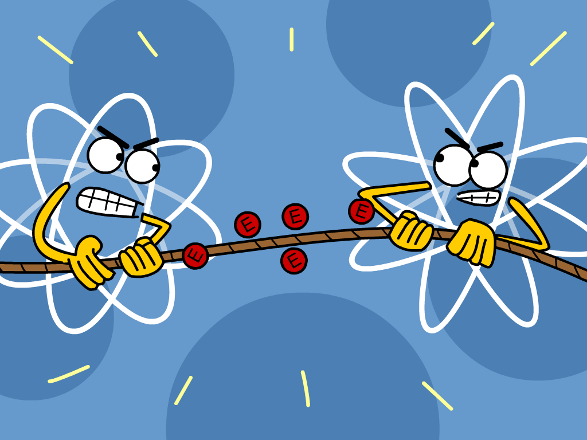
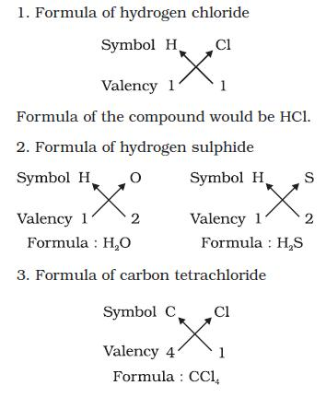
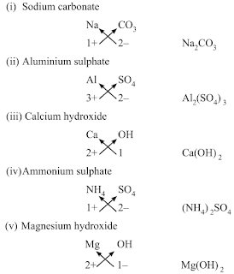
Some examples of simple and polyatomic ions
6
Writing Chemical Formulae:
→ Chemical formulae of a compound are the symbolic representation of its composition.
→Learning the chemical symbols of various elements is a must.
→ The combining power (or capacity) of an element is known as ‘Valency’. It helps in finding out how the atoms of an element will combine with the atoms of another element to form a compound.
→ Valency basically tells us how many of the other element is needed to fill the atomic shells of all the combining elements in a compound.
RULES FOR WRITING A CHEMICAL FORMULA:
1. The Valencies or charges on the ion must balance.
2. In compounds with both metal and non-metal, Name of metal comes first.
Ex: NaCl (Sodium Chloride)
3. In compounds with polyatomic ions, the number of ions is indicated by enclosing the formula of ion in a bracket and writing the number of ions outside the bracket.
Ex: Mg(OH)₂
4. If the the number for polyatomic ion is one, the bracket is not required.
Ex: NaOH
Formulae of Simple Compounds:
*Check page 38 – 39 in NCERT Science book.
Practice each example given in here and in the book.

Slide 9

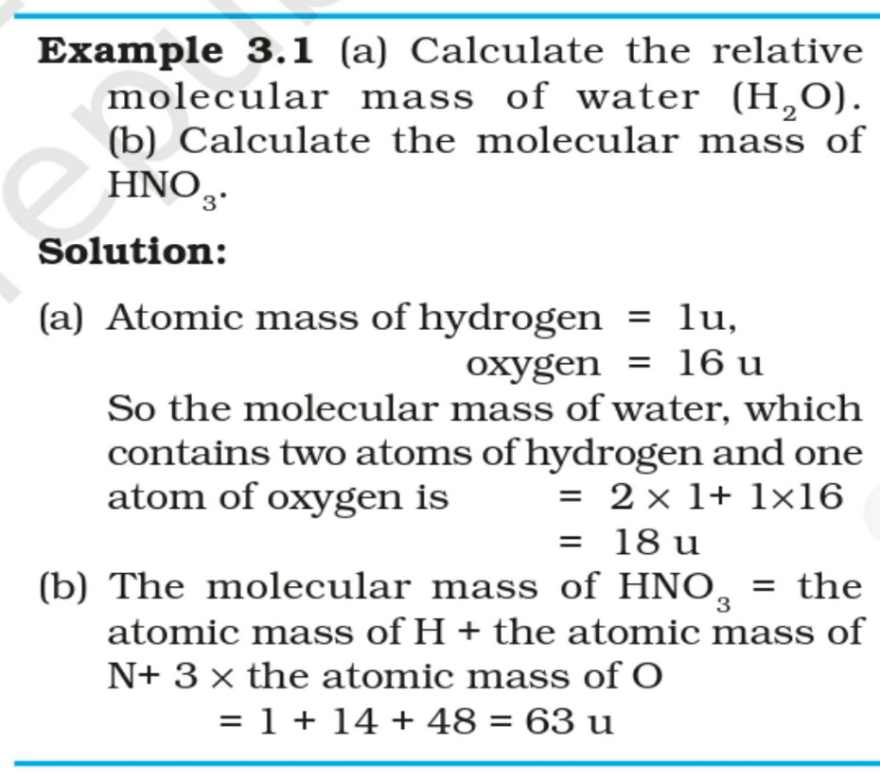
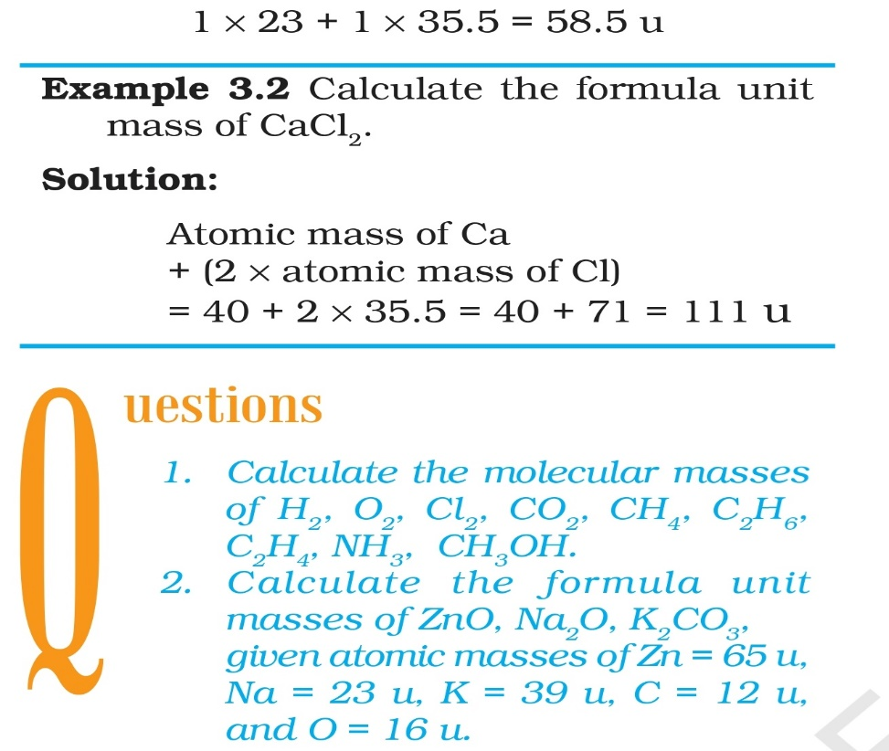
7
Molecular mass and formula unit mass
*Both are calculated in the same manner.
The molecular mass of a substance is the sum of the atomic masses of all the atoms in a molecule of the substance.
*Ex: The population of a country is calculated by considering every citizen. Similarly in molecular mass, the mass of each atom will be added.
→ Formula unit mass of a substance is a sum of the atomic masses of all atoms in a formula unit of a compound.
The Molecular mass
The formula unit mass of NaCl

Slide 10
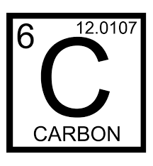
Atomic number
8
Mole Concept:
This is 1 mole of Carbon (6.022 x 10²³) – aka: Avogadro number.
Atomic Mass
Molar mass (aka- Gram atomic mass)
Helium (atomic number is 2 and atomic mass is 4u)
Molar mass is 4g which is 1 Mole
((6.022 x 10²³)
Nitrogen (atomic number is 7 and atomic mass is 15u)
Molar mass is 15g which is 1 Mole
(6.022 x 10²³)
Sodium (atomic number is 11 and atomic mass is 22u)
Molar mass is 22g which is 1 Mole
(6.022 x 10²³)

Slide 11
1. It is a unit of measurement in which 1 mole of any particle (atoms, molecules or ions) is 6.022 x 10²³ (number of that particle).
2. Atomic mass = Gram atomic mass (aka-Molar mass) Ex: H (1u) = H (1g) C (12u) = C(12g)
3. The mass of 1 mole of a substance is equal to its relative atomic or molecular mass in grams.
4. Molar mass = 1 mole (Mass of 1 mole of any substance is called its Molar mass. Ex: C (12g) = 1 mole (6.022 x 10²³). →Molar mass of atoms is also known as gram atomic mass. Ex: atomic mass of H = 1u and gram atomic mass of H = 1g. Therefore, 1g of H = 1 mole of H i.e., 6.022 x 10²³
*To find the number of moles in grams(n) = Given mass is ÷ Molar mass.
*to find the number of moles in number of particles = Given number of particles ÷ Avagadro number (6.022 x 10²³).
5. The number of particles present in 1 mole of any substance is fixed and is called Avagadro constant or Avagadro number (No) i.e., 6.022 x 10²³.
Note: I tried my best to deduce the explanation as brief as possible. If you feel confused, feel free to go for a walk and listen to music of your choice.

Slide 12
*Check the examples 3.3, 3.4 and 3.5 given in the NCERT class 9 science book to comprehend how to find out the mass of moles of different elements.
Discuss with peers and teachers.
A Video lesson on each example will be upload in future.
Feel free to comment your doubts and watch other videos on the same topic for better understanding.
As Confucius once said, “The man (person) who asks a question is a fool for a minute, the man (person) who does not ask is a fool for life”.

Slide 13
Visit www.rangjong.com for more such resources.

