Slide 1

General knowledge
Tibet and Tibetans

Slide 2
General knowledge
Tibet and Tibetans

Slide 3
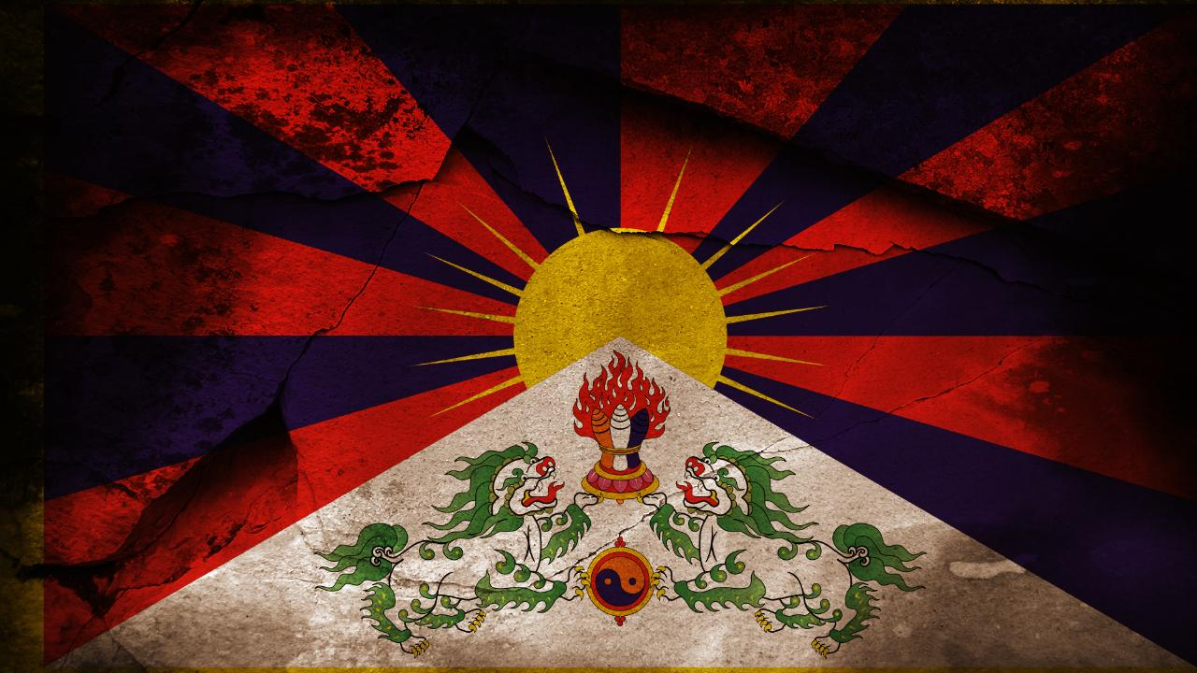
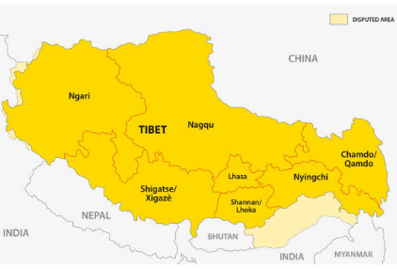
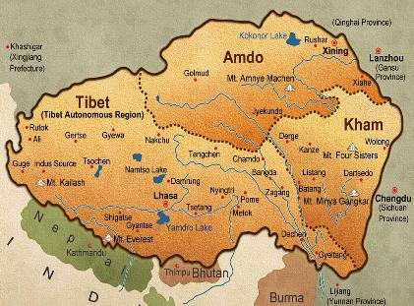

བོད་པའི་ས་ཁྲ་གང་ཡིན་ནམ།
1
Next slide

Slide 4
བོད་ལ་ཆོལ་ཁ་ག་ཚོད་ཡོད།
2
༡
༢
༣
༤
Next slide

Slide 5
བོད་པ་མི་འབོར་ག་ཚོད་རེད་དམ།
3
ས་ཡ་ལྔ་
ས་ཡ་དྲུག་
ས་ཡ་བདུན་
ས་ཡ་བརྒྱད་
Next slide

Slide 6



Tibet belongs to_____?
4
Indians
Chinese
USA
Tibetan
Next slide

Slide 7
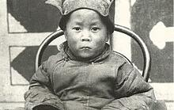
What is the birth name of
His Holiness the 14th Dalai Lama?
5
Tenzin Kalden
Lhamo Dhondup
Tenzin Gyatso
Dalai Lama
Next slide

Slide 8
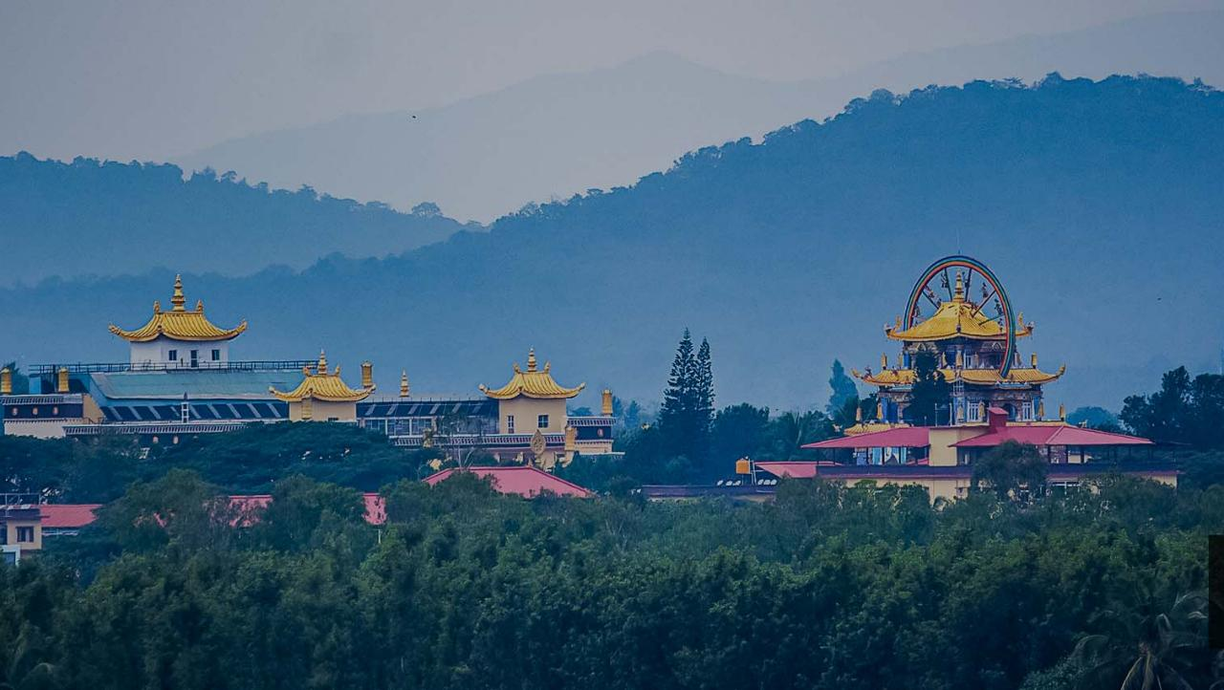
Where was the first Tibetan
settlement established in India?
6
Hunsur
Byllakupe
Mussoorie
Dharamshala
Next slide

Slide 9
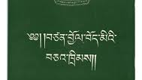
What is the Charter of the
Tibetans in Exile?
7
The essay written by sir Charter about Tibetans
The constitution guiding Tibetans in exile.
The constitution guiding Tibetans in Tibet.
17-point agreement
Next slide

Slide 10
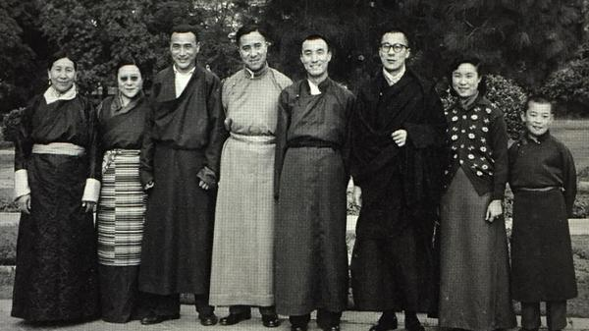
Who is the eldest among
the following?
8
Gyalo Dhondup
Tsering Dolma
Tenzin Gyatso
Jetsun Pema
Next slide

Slide 11
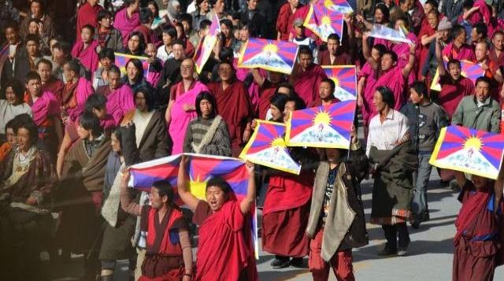
Who composed the
Tibetan national anthem?
9
Trijang Rinpoche
Panchen Rinpoche
Ling Rinpoche
Gyalwa Rinpoche
Next slide

Slide 12
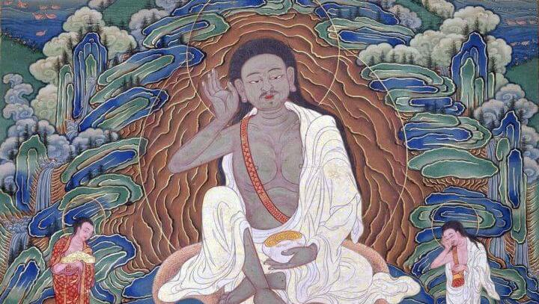
Which of the following
Buddha’s was a Tibetan?
10
Sangey Jampa Gompo
Sangey ShakyaThupa
Sangey Milarepa
Guru Rinpoche
Next slide

Slide 13
Thank you!

Slide 14
Correct

Slide 15
འགྲིག་སོང་།

Slide 16
INCORRECT!

Slide 17
ནོར་སོང་།

