Slide 1


Slide 2
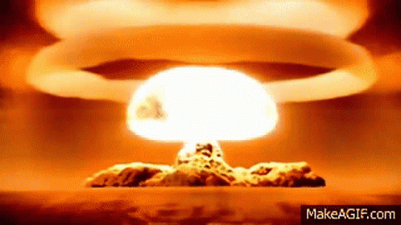


Slide 3

Chemical reaction and equation
Class X, ch-1
Created by: Tenzin Kalden, rangjong.com

Slide 4
Chemical reaction: a process in which one/more substances are changed into new substance.
Observations that help us determine taking place of a chemical reaction are:
  Change in state (solid, liquid or gas)
  Change in colour.
  Evolution of gas.
  Change in temperature.
Created by: Tenzin Kalden, rangjong.com

Slide 5
a. Chemical equations: are the descriptions of chemical reaction.
Reaction:
A
B
AB
LHS: Reactants
RHS: Product:
Created by: Tenzin Kalden, rangjong.com

Slide 6
1. Word equation: It is the way of writing chemical reactions in words.
Ex: Sodium hydroxide + Hydrochloric acid → Sodium chloride + water
2. Symbol equation: It is the way of writing chemical reactions using chemical symbols.
Ex: NaOH + HCl → NaCl + H₂O
Other examples:
Ex: Magnesium + oxygen → Magnesium oxide (MgO)
Mg + O₂ → MgO (*see how it is unbalanced? This is called a skeletal equation. We must balance the equation by comparing and changing the number in the coefficient.)
Balanced: 2Mg + O₂ → 2MgO
Sodium hydroxide
Sodium chloride
Elements | Lhs | Rhs
Mg | 1 x 2 = 2 | 2
O | 2 | 2
Coefficient: The place before the element.
Created by: Tenzin Kalden, rangjong.com

Slide 7
B. Balancing chemical equations:
Steps:
Make a box around every chemical formula. Don’t change anything inside the box.
Compare and list the number of atoms of each element.
Multiply with respective number to balance.
Example:
Fe
H₂O
Fe₃O₄
H₂
Balanced:
Iron oxide
Element | Lhs | Rhs
Fe | 1 x 3 = 3 | 3
H | 2 (8) | 2 x 4 = 8
O | 1 x 4 = 4 | 4
3
4
4
H₂
Fe
H₂O
Fe₃O₄
Created by: Tenzin Kalden, rangjong.com

Slide 8
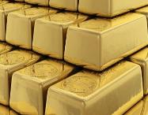

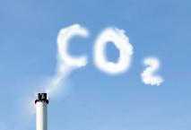
C: writing symbols of physical states:
Solid (s)
Liquid (l)
Aqueous (aq)
Gaseous (g)
*Catalyst: Is a substance that increases the rate of a chemical reaction with itself undergoing no chemical change.
→ Potassium permanganate (KMnO4)
Created by: Tenzin Kalden, rangjong.com

Slide 9
D: types of chemical reactions:
1. Combination reaction | 2. Decomposition reaction
* When a single product is formed from two or more reactants. Or when two or more reactants combine to form one product. | *When a single reactant breaks down to give (multiple) simpler products. → It requires energy in the form of heat, electricity or sunlight.
Ex:1. Burning of coal: * C(s) + O₂ (g) → CO₂ (g) | Ex: Types: Heat: i. 2FeSO₄(s) Fe₂O₃(s)+SO₂ (g) + SO₃ (g) ii. CaCO₃ CaO + CO₂
2. Formation of water: 2H₂ (g) + O₂ → 2H₂O | b. Sunlight: * 2AgCl(s) → 2Ag + Cl₂ (g)
3. Formation of slaked lime: CaO(s) + H₂O(l) → Ca(OH) ₂ (aq) | c. Electricity: *2H₂O(l) → 2H₂ (g) + O₂ (g)
Ferrous sulphate
Ferric oxide
Sulpher dioxide
Sulpher trioxide
Calcium carbonate
Silver chloride
Quick lime / Calcium monoxide
Calcium hydroxide
Created by: Tenzin Kalden, rangjong.com

Slide 10
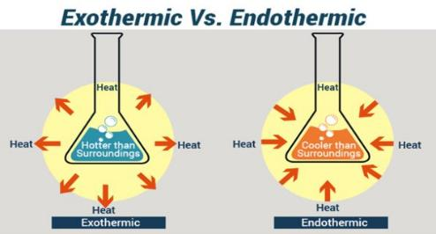
Exothermic reaction:
→ When heat is released along with the formation of products.
Ex:
1. Burning of natural gas:
CH₄ (g) + 2O₂ (g) CO₂ (g) + 2H₂O(l)
2. Breaking down of glucose:
C₆H₁₂O₆ (aq) + 6O₂ 6CO₂ (aq) + 6H₂O(l)
+Energy
Methane gas
Glucose
Endothermic reaction: Decomposition reactions are examples of endothermic reaction as it absorbs heat energy.
Created by: Tenzin Kalden, rangjong.com

Slide 11
3. Displacement reaction | 4. Double displacement reaction
* When an element displaces another element from its compound. | When two different atoms/groups of atoms or ions are exchanged. As precipitates are formed in this reaction, it is also called ‘Precipitation reaction’.
Ex: a. Fe(s) + CuSO₄ (aq) → FeSO₄ (aq) + Cu(s) Copper sulphate Ferrous sulphate | Ex: Na₂SO₄ (aq) + BaCl₂ (aq) → BaSO₄ (aq) + 2NaCl(s)
Sodium sulphate
Barium sulphate
Barium chloride
Sodium chloride
5. REDOX REACTION
REDUCTION REACTION | OXIDATION REACTION
*Loss of oxygen and gain of hydrogen. | *Gain of oxygen and loss of hydrogen.
Ex: CuO + H₂ Cu + H₂O
Copper oxide
OXIDATION
Check other examples as well
REDUCTION
Created by: Tenzin Kalden, rangjong.com

Slide 12
6. Corrosion | 7. Rancidity
a. It is a process in which metals are slowly eaten up by the action of air, moisture or chemicals. | a. It is a natural process of decomposition of fat and oil.
b. The chemical substances in the environment reacts with the metal and deteriorates it. | b. It occurs due to oxidation or hydrolysis.
c. The corrosion leads to formation of reddish brown coating of iron, black coating of silver and green coating of copper | c. Food becomes rancid due to deterioration of fat.
 | d. Factors for rancidity: i. Exposure to air for long duration. ii. Heat. iii. Light. iv. Water.
 | e. Rancidity leads to change in smell and taste of food.
CORROSION
RED
(IRON)
GREEN (COPPER)
BLACK (SILVER)
CORROSION EX: RUSTING OF IRON
4Fe + 3O₂ → 2Fe₂O₃ (Ferric oxide)
Created by: Tenzin Kalden, rangjong.com

