Slide 1


Slide 2
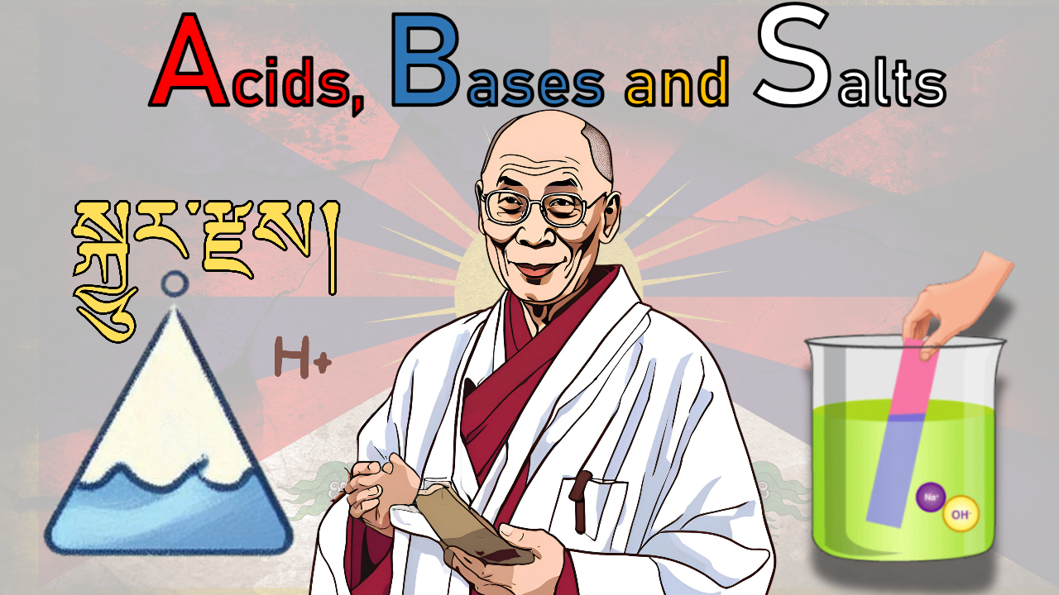
Class X: Ch – 2
Created by: Tenzin Kalden, rangjong.com

Slide 3
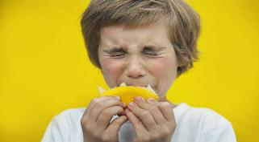
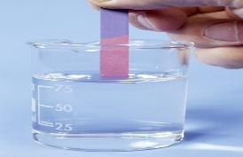
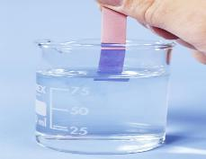
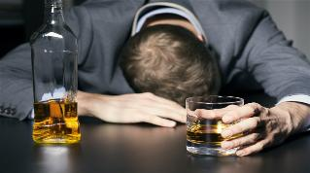
A
Characteristics of Acids and bases
S.No | ACIDS | BASES
1 | Sour in taste | Bitter in taste
2 | Has pH lower than 7 | Has pH higher than 7
3 | Turns blue litmus paper into red | Turns red litmus paper into blue
4 | Gives H+ ions in aqueous solution. | Gives OH- ions in aqueous solution.

Slide 4
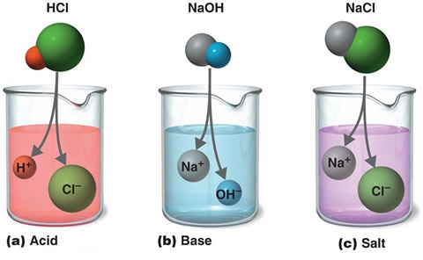
Created by: Tenzin Kalden, RangJong Find us on www.rangjong.com

Slide 5
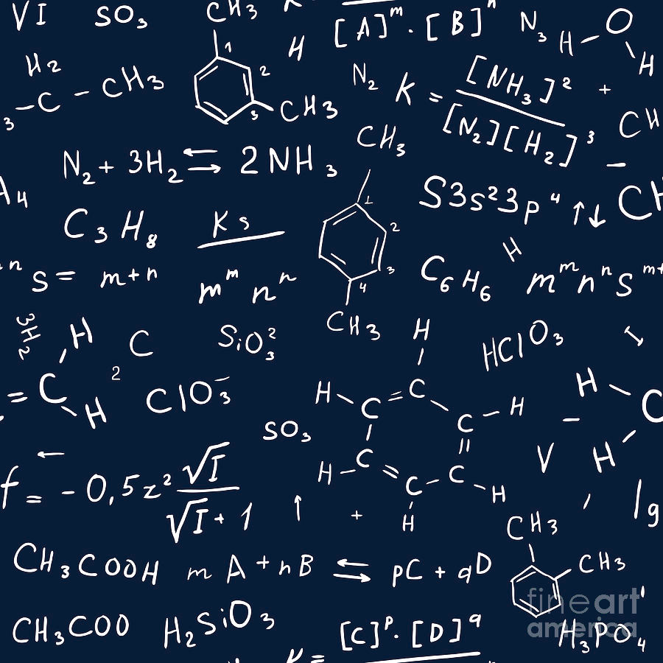
Examples:
ACID |  | BASE
Chemical name | Chemical formula | Chemical name | Chemical formula
1. Hydrochloric acid | HCl | 1. Sodium hydroxide | NaOH
2. Sulphuric / Sulfuric acid | H₂SO₄ | 2. Potassium hydroxide | KOH
3. Nitric acid | HNO₃ | 3. Calcium hydroxide | Ca(OH)₂
4. Acetic acid | CH₃COOH | 4. Ammonium hydroxide | NH₄OH
Created by: Tenzin Kalden, RangJong Find us on www.rangjong.com

Slide 6
B
Acid & base indicators
Created by: Tenzin Kalden, RangJong
Find us on www.rangjong.com
Origin | Indicator | Indication for acid | Indication for base
NATURAL INDICATOR | LITMUS | RED | BLUE
 | RED CABBAGE LEAF EXTRACT | RED | GREEN
 | FLOWER OF HYDRANGEA PLANT | BLUE | PINK
 | TURMERIC | NO CHANGE | RED
SYNTHETIC INDICATOR | PHENOLPHTHALEIN | COLOURLESS | PINK
 | METHYL ORANGE | RED | YELLOW
OLFACTORY | ONION | ITS OWN SMELL | NO SMELL
 | VANILLA ESSENCE | RETAINS SMELL | NO SMELL
 | CLOVE OIL | RETAINS SMELL | LOSES SMELL

Slide 7
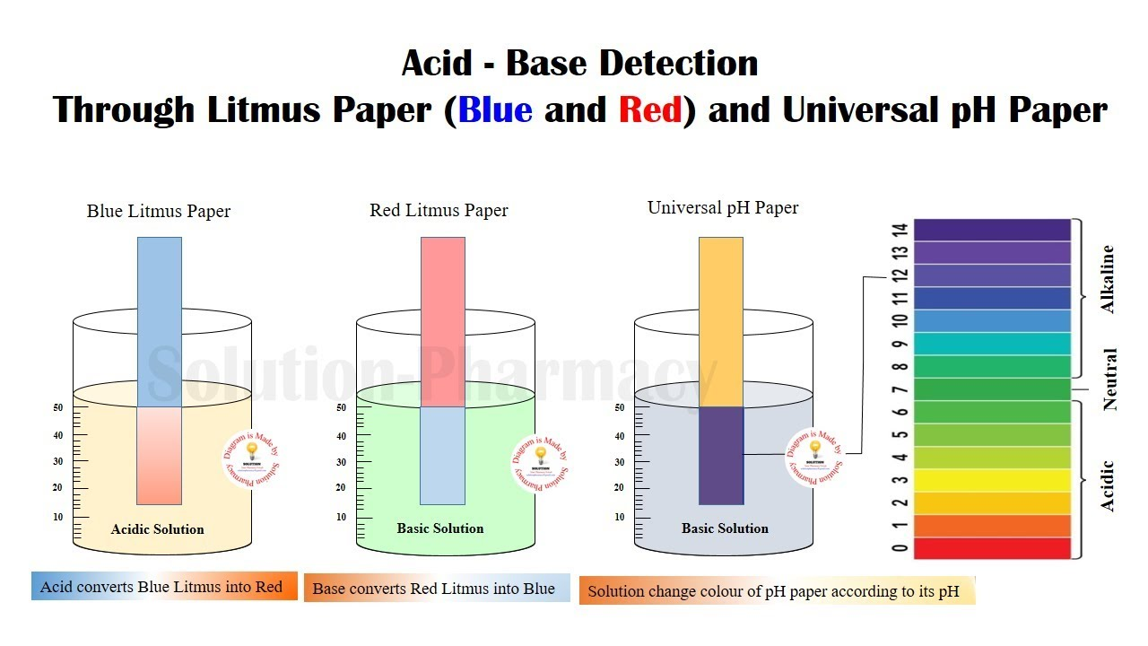

Slide 8
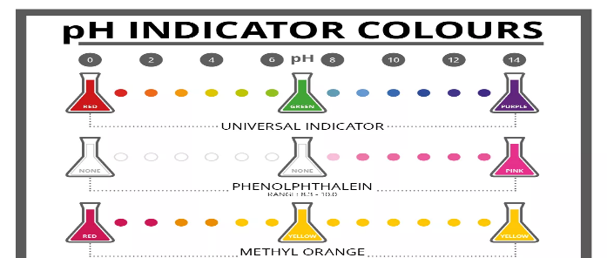
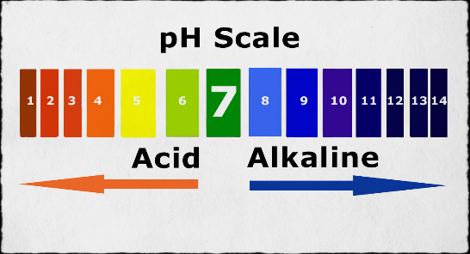
c
pH strength of acid and bases
The strength of acid and base depends on the no. of H+ ions and OH- ions.
With the help of pH scale and following acid-base indicators, we can determine the strength of acidic and basic nature of any solution.
Created by: Tenzin Kalden, RangJong Find us on www.rangjong.com

Slide 9
D
Reaction of acid and base with metals
Acid + metal → Salt + hydrogen gas
2HCL + Zn (Zinc) → ZnCl₂ + H₂
Base + metal → Salt + hydrogen gas
2NaOH + Zn (Zinc) → Na₂ZnO₂ + H₂
Sodium zincate
Both acid and base reacts with metals to evolve H₂ gas.
Note that all metals do not react with bases. The metal must be more reactive than the metals in bases to react.
→ H₂ gas released can be tested by bringing burning candle near gas bubbles. It bursts with a pop sound.
Created by: Tenzin Kalden, RangJong Find us on www.rangjong.com

Slide 10
E
Reaction of acids with metal carbonates and metal hydro-carbonates
Acids react with metal carbonates and metal hydro-carbonates to form salts, CO₂ and water.
    OR
    EX: 1. 2HCL + Na₂CO₃ → 2NaCl + CO₂ + H₂O
    (Sodium carbonate)
    2. HCL + NaHCO₃ → NaCl + CO₂ + H₂O
    (Sodium bicarbonate)
    Note: bases do not react with metal carbonates and metal Hydro-carbonates.
Salts, carbon dioxide and water.
Metal carbonate
Metal hydro- carbonate
ACID
Created by: Tenzin Kalden, RangJong Find us on www.rangjong.com

Slide 11
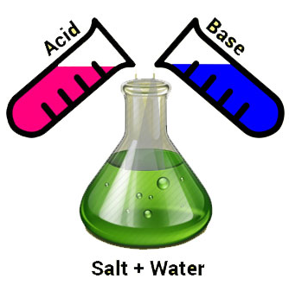
F
Neutralization reaction
It is the reaction of acid with base which leads to formation of salt and water.
ACID + BASE → SALT + WATER
Ex: HCL + NaOH → NaCl + H₂O
STRONG acid + weak base → Acidic salt + water
weak acid + STRONG base → Basic salt + water
STRONG acid + STRONG base → Neutral salt + water
weak acid + weak Base → Neutral salt + water
Created by: Tenzin Kalden, RangJong Find us on www.rangjong.com

Slide 12
G
Reaction of acid and base with water
ACID
HCL + H₂O → H₃O⁺ + Cl ⁻
The separation of H+ ions from HCL molecules cannot occur in the absence of water.
Since H+ cannot exist alone, they combine with water to form H₃O⁺ (hydronium) ion.
BASE
H₂O
NaOH + H₂O Na⁺ + OH⁻
Bases generate OH ⁻ (hydroxide) ions in water.
Water soluble bases are called Alkalis.
NOTE: The process of dissolving an acid or base in water is a highly exothermic reaction. Proper precautions and care are required before and while mixing conc.HNO3 / H2SO4 in water.
Add acids slowly with constant stirring.
Never add water to acid.

Slide 13
H
Chemicals obtained from common salt
NaCl (Salt)
NaOH Sodium hydroxide
NaHCO₃ Sodium bicarbonate
Na₂CO_{3 Sodium carbonate}
CaOCl₂ Bleaching powder
NaOH
Electrolysis of aq. Sodium chloride.
REACTION:
2NaCl (aq) + 2H₂O (l) → 2NaOH (aq) + Cl₂ (g) + H₂ (g)

Slide 14
B. Bleaching powder (CaOCl₂): aka- calcium oxychloride.
Ca(OH)₂ + Cl₂ → CaOCl₂ + H₂0
(Calcium hydroxide) (Calcium oxychloride)
Used: 1. for bleaching clothes (cotton & linen), wood pulp in paper factories etc.
2. As an oxidizing agent.
For disinfecting drinking water.
C. Baking Soda (NaHCO₃ ): aka- Sodium bicarbonate
NaCl + H₂0 + CO₂ + NH₃ → NH₄Cl + NaHCO₃ ( sodium chloride) (Sodium bicarbonate)
Used for: 1. for cooking and making baking powder.
2. Ingredient in antacid and used in fire extinguishers.
D. Washing soda (Na₂CO₃): aka- Sodium carbonate
2NaHCO₃ + Heat or H+ ion → Na₂CO₃
(Sodium bicarbonate) (Sodium carbonate)
Na₂CO₃ + 10 H₂0 → Na₂CO₃.10 H₂0
(Sodium carbonate hydrate)
Used in: 1. manufacturing glass, soap and paper industries.
2. In making borax.
3. As a cleaning agent.
Created by: Tenzin Kalden, RangJong Find us on www.rangjong.com

Slide 15

It is the fixed number of water molecules present in one formula unit of a salt.
i
Water of crystallization
Crystals of salts may seem and feel dry but aren’t.
They contain water of crystallization.
Ex:
Hydrated copper sulphate
→ CuSO₄.5H₂O
Gypsum: aka- Hydrated Calcium Sulphate
→ reaction in the next slide.
* On heating gypsum at 373K or 100°C, it loses its water molecules and become P.O.P.
Created by: Tenzin Kalden, RangJong Find us on www.rangjong.com

Slide 16
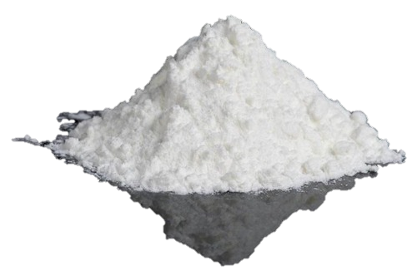
J
Reaction of Plaster of Paris (P.O.P) with water:
P.O.P – aka Calcium Sulphate hemihydrate.
CaSO4.^{1/2}H2O + 1^{1/2}H2O → CaSO₄.2H₂O
(P.O.P) (Gypsum)
Applications:
Used for supporting fractured bones in the right position.
Also used for making toys, decorative materials, protective coating on walls and ceilings, aesthetic finishing touches to buildings, dental models etc.

