Slide 1

Visit www.rangjong.com for more such resources.

Slide 2
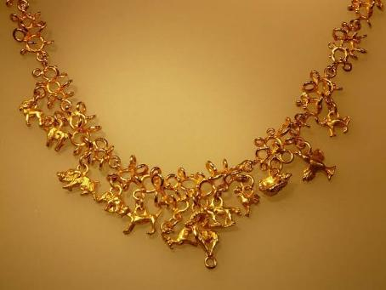
IS MATTER AROUND US PURE
Class 9, chapter - 2
Created by: Tenzin Kalden, founder of rangjong.com

Slide 3










Matter
a. Non living
Gases
Solid
Liquid
b. Living
1. Microorganisms
2. Plants
3. Animals
* Write down two examples of each types of matter.

Slide 4
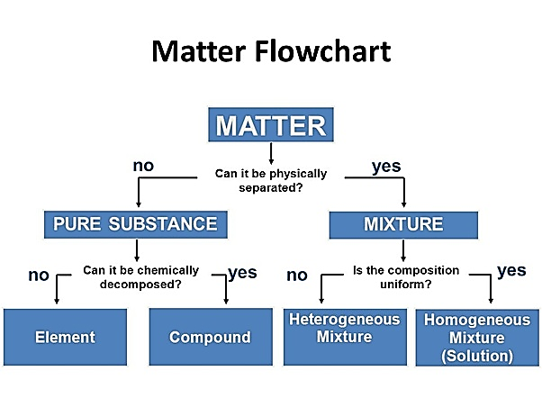
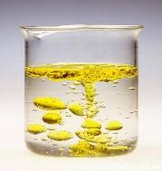
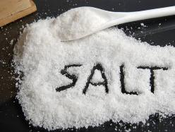
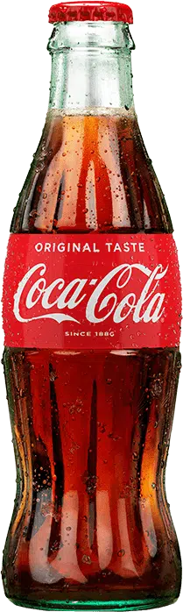
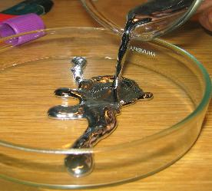
In chemistry, matter is classified as:
* Write two more examples in each type of pure and mixture.
Classify the following in their group:
Oil in water
Or Impure
Iron
Water
Pizza
Tea
Mercury

Slide 5
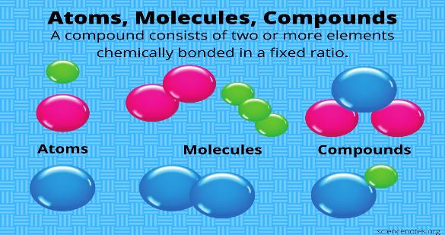
Pure substances
TYPES
ELEMENTS | COMPOUNDS
* It is the unit/basic form of matter that cannot be broken down into simpler substances using chemical reactions. | * A compound is a substance composed of two or more different elements, chemically combined with one another in a fixed proportion.
Types: Metals, non-metals and metalloids. | Types: Ionic compound and covalent compound.
Examples: Iron, oxygen, carbon, hydrogen, mercury. | Examples: Salt, water, methane, sugar etc.
PROPERTIES
Metals | Non-metals
1. Have luster (shine). | 1. Don’t have luster (shine).
2. Good conductor of heat and electricity. | 2. Poor conductor of heat and electricity.
3. Are ductile (wire), malleable (sheet) and aren’t sonorous (ringing sound). | 3. Aren’t ductile (wire) nor malleable (sheet) and aren’t sonorous (ringing sound).
Examples: Iron, mercury, sodium, potassium etc. | Examples: Carbon, hydrogen, oxygen etc.

Slide 6
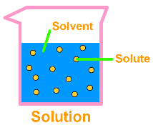
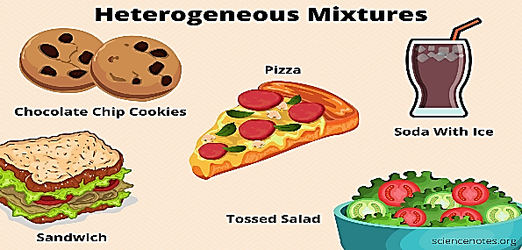
Mixtures
→ When two or more substances are mixed together in any proportion, it is called a mixture.
TYPES
HOMOGENOUS MIXTURE | HETEROGENOUS MIXTURE
* When the composition of a mixture is uniform at the particle level, it is called, a homogenous mixture. Aka- solution. | * When the composition of a mixture is not uniform (non-uniform), it is called, a heterogenous mixture.
Ex: Lemonade, air, salt or sugar in water, soda etc. | Ex: Water in oil, milk, sand in water, biryani etc.
SOLVENT:
*The substance in higher concentration is called a solvent.
Solute:
*The substance in lower concentration.

Slide 7
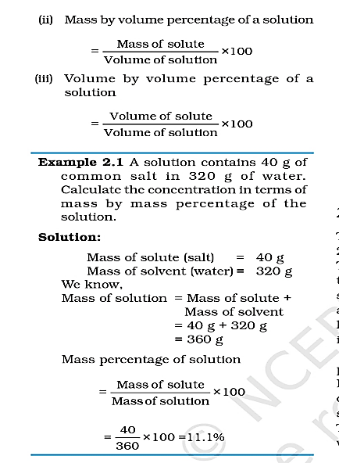
Homogenous mixture: aka - Solution
Soda water
Solvent:
Water
Solute:
CO2
Sugar water
Solvent:
Water
Solute:
Sugar
When two or more substances are mixed uniformly, it is called a homogenous mixture or solution.
On the basis of amount/concentration of the substances dissolved in a given mass or volume, the substance is named either solute or solvent.
The particles are not visible to the naked eye and cannot scatter a beam of light.
Saline water
Solvent:
Solute:
Coca cola
Solvent:
Solute:
Air
Solvent:
Solute:
Vinegar
Solvent:
Solute:
How to find the concentration of a solution:
Two formulae: → i. Mass of solute / Mass of solution x 100
ii. Mass of solute / volume of solute x 100
Example: 2.1 (page 17)
Guess which is solute and which is solvent among the following examples:

Slide 8
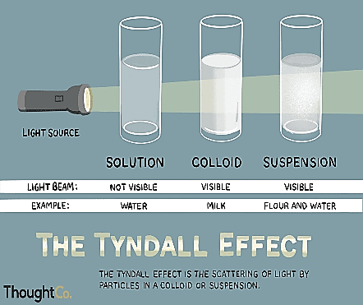
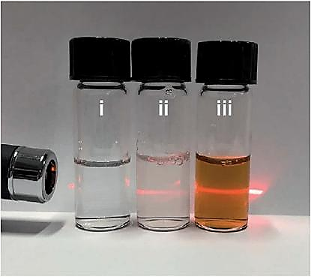
Heterogenous Mixtures:
Types
Suspension
Colloidal
A suspension is a heterogenous mixture in which the solute particles do not dissolve but remain suspended in the medium.
The particles of a suspension are visible to the naked eye.
Its particles can scatter a beam of light passing thought it.
It is unstable as the solute particles settle down when left undisturbed.
Method of separation: Filtration
Ex: Muddy water, oil in water, yolk in egg etc.
A colloidal solution is also a heterogenous mixture but it may appear homogenous as its particles are uniformly distributed throughout the solution.
The particles are not visible to the naked eye as they are very small.
We know it is a heterogenous mixture because its particles can scatter a beam of light. This phenomenon of scattering of light due to particles is called ‘Tyndall effect’.
It is a stable mixture as the particles do not settle down when left undisturbed.
Example: Milk.

Slide 9
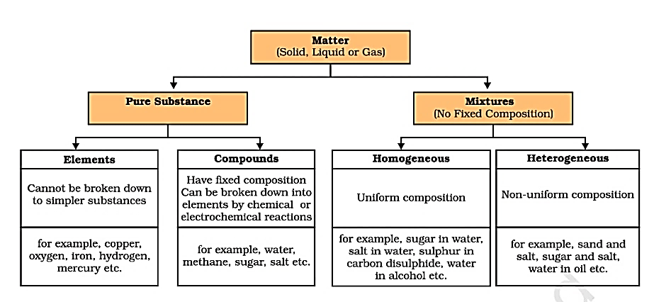
Important Recapitulation

Slide 10
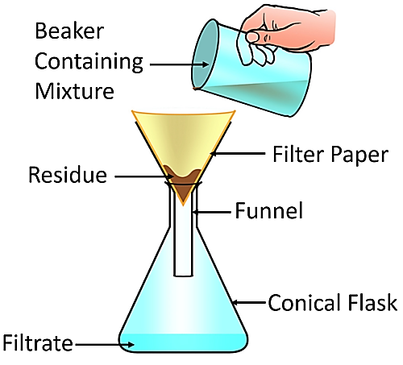
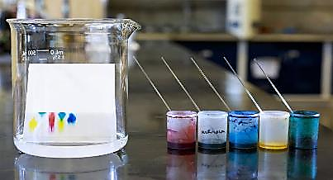
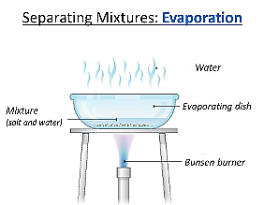
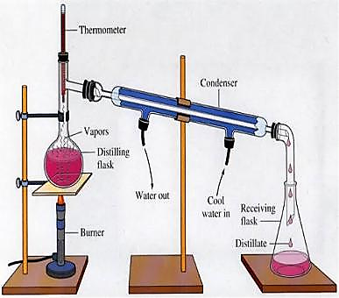
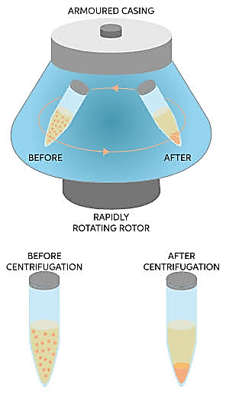
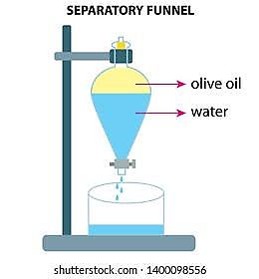
Methods of separation:
Chromatography
Filtration | * By using filter paper and a funnel, one can easily separate heterogenous mixtures with large particles.
2. Evaporation | * To separate water from ink or salt from water, we can simply boil the solution and easily separate the two components.
3. Centrifugation | * By using a machine called ‘Centrifuge’, which works on the principle of sedimentation, we can separate cream from milk, blood cells and plasma from blood etc.
4. Separating funnel | By using this instrument, we can easily separate immiscible liquids that are put together. Ex: mixture of oil and water.
5. Sublimation (solid to gas) | When two solids (powdery) are mixed, one can sublime before the other upon heating do to difference in heat tolerance. Ex: Heating a mixture of salt and ammonium chloride.
6. Chromatography | * It is used to analyze contents of mixtures and as a purification tool. It is used in food testing, beverage testing, drug and forensic testing etc.
7. Distillation | This method is used to separate a mixture of two miscible liquids. For this, distillation flask is a must and the method depends on the difference in the boiling point of the two liquids. Ex: purification of alcohol, obtaining various gases from air such as Oxygen in oxygen cylinder.
Distillation
Centrifugation

Slide 11
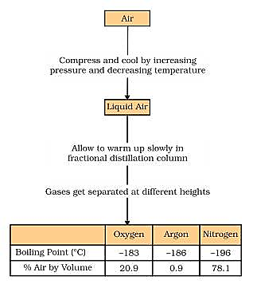
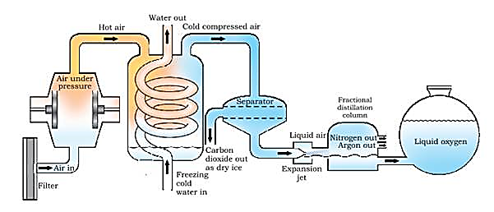
Obtaining different gases from air:
* Air is a homogenous mixture that can be separated into its components by fractional distillation.
Fractional distillation is similar to the normal distillation where mixture is heated and then cooled. But in Fractional distillation, a tube filled with glass beads is fitted to the distillation flask.
It helps in obtaining different gases separately for their uses. Such as oxygen cylinder, hydrogen and Nitrogen gas cylinder.
Follow the arrow from left to right.

Slide 12


C
R
Y
S
T
A
L
L
I
Z
A
T
I
O
N
It is the process of separating a pure solid in the form of its crystals from an impure sample/solution.
Water is added to the solution which is then covered with a filter paper and left undisturbed to evaporate slowly.
This help obtain crystals of the desired substance from the impure sample.
Purification of salt from sea water.
Sugar crystals from sugar juice.
EXAMPLES

Slide 13

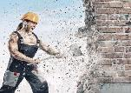
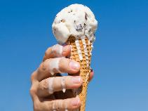
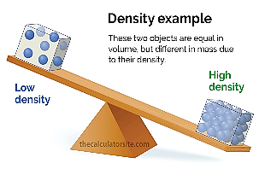
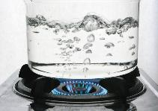
Change
Physical and
Chemical
Physical properties:
Physical properties of matter include colour, hardness, rigidity, fluidity, density, melting and boiling point etc.
PHYSICAL CHANGES | CHEMICAL CHANGES
1. Any change in the physical properties that doesn’t change the chemical property of the substance. | 1. Any change that brings changes in the chemical properties in the substance and create a new chemical compound or substance.
2. It is a reversible process. | 2. It is an irreversible process.
Ex: Interconversion of states of water, ice and water vapour, folding of paper and clothes etc. | Ex: Burning of paper, germination of seeds, making tea and coffee etc.
* Burning of candles is both physical and chemical change. Can you name two other examples that is both physical and chemical change?

Slide 14
Visit www.rangjong.com for more such resources.

